Slide 1
Online Shopping Project
NOSENTE GOLL, MARLEY CURTIS & NOOR BAAKZA

Slide 2
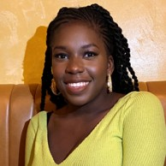
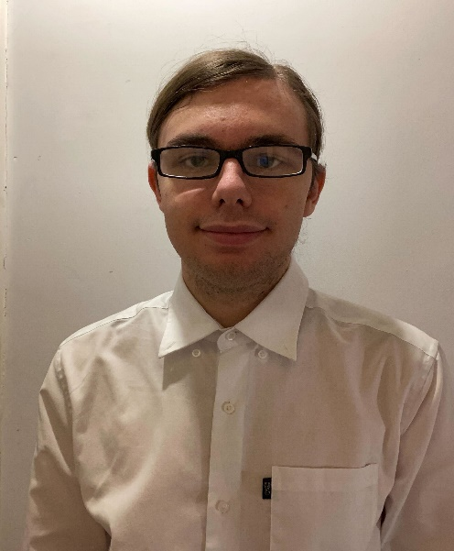
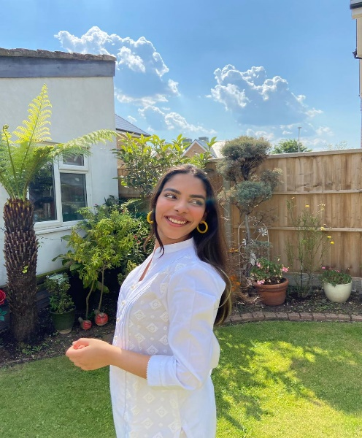
Meet the Team
Nosente Goll
Scrum Master
Marley Curtis
Back End Developer
Noor Baakza
Front End Developer

Slide 3
Purpose
TO CREATE AN ONLINE SHOPPING WEBSITE AND BE ABLE TO HAVE A PROFILE THAT CAN CHECKOUT ITEMS
Notes:
The purpose of our project was to create a online shopping website, where the user is able to create a account and login in order to order the items that they would like and check them out.

Slide 4
Requirements
Registration
Login
Profile Page
Products
Basket
Proceed to checkout

Slide 5
LIFE CYCLE
Scrum Meeting
Roles and Tasks
Database Development
Presentation Planning
Agile
Daily Standups
Sprint Lengths
Sprint lengths were a couple of days
Road Blocks
Limitations and Extenuating circumstances

Slide 6
Development Tools
Back End
JavaScript
CSS
Bootstrap
HTML
MySQL
PHP admin
Java
Spring
JPA
Junit Testing
Front End
Database

Slide 7
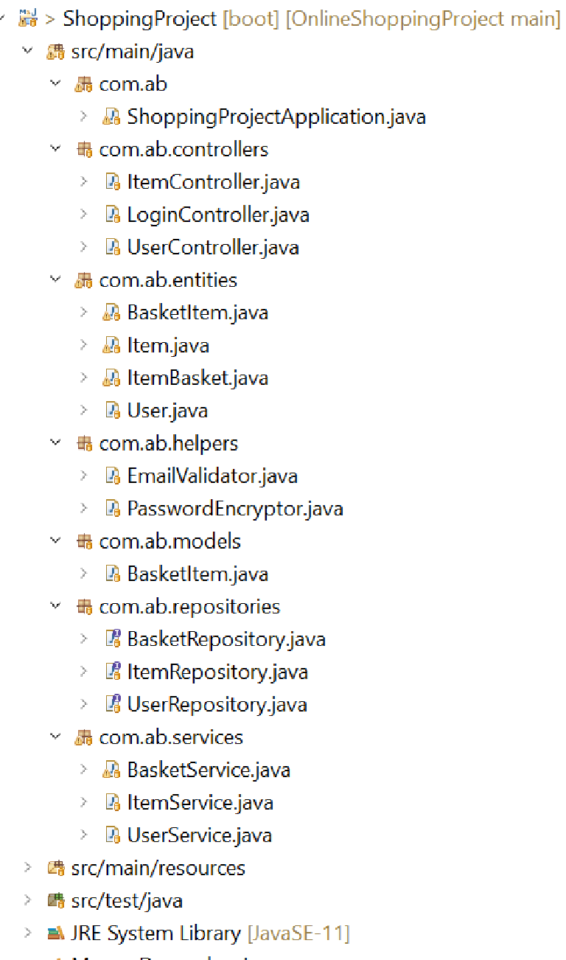
Back End Structure
The back end is organised using the MVC (Model, View and Controller) structure.
Repositories are used to access the database content.
Services is where the business logic for each entity takes place.

Slide 8
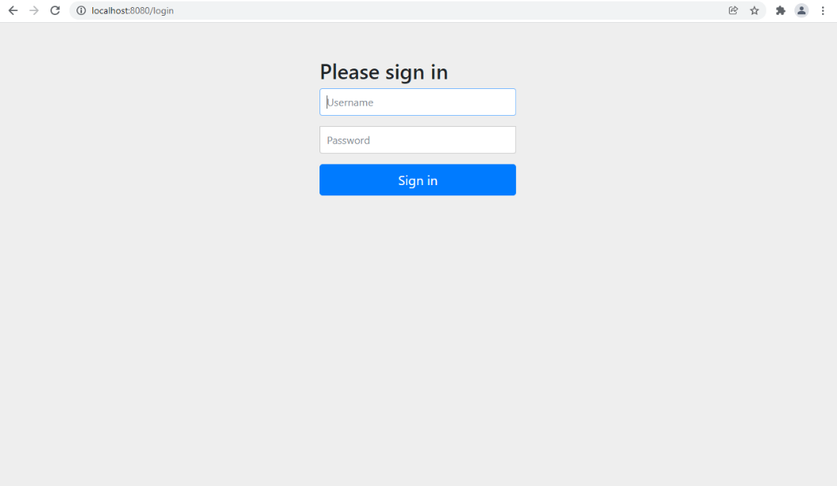
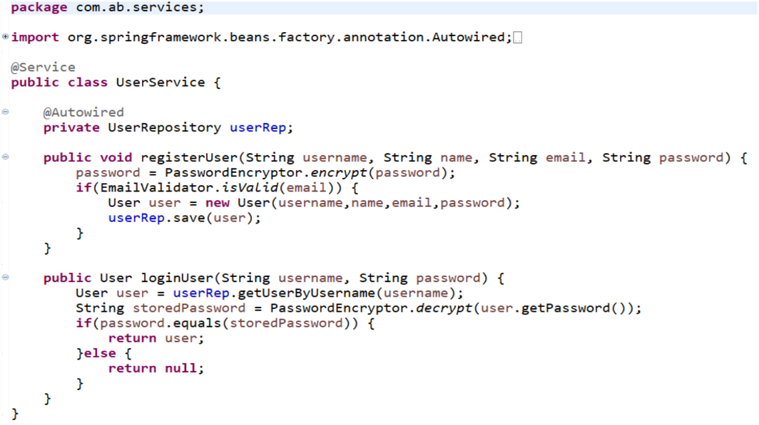
Development
FRONT END
BACK END

Slide 9
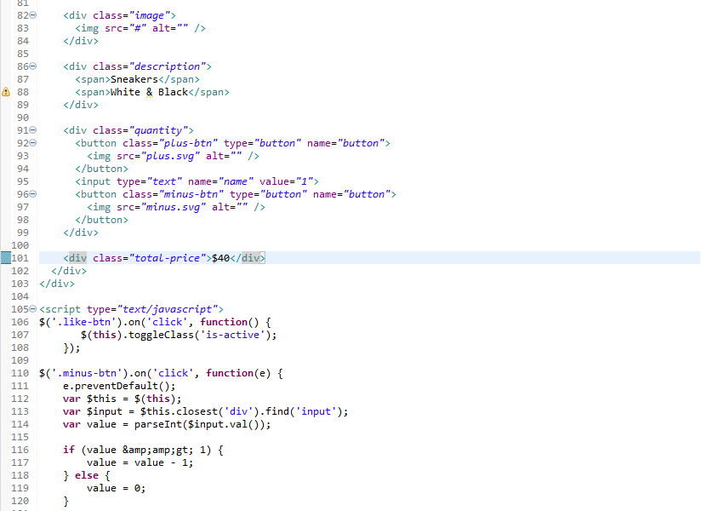
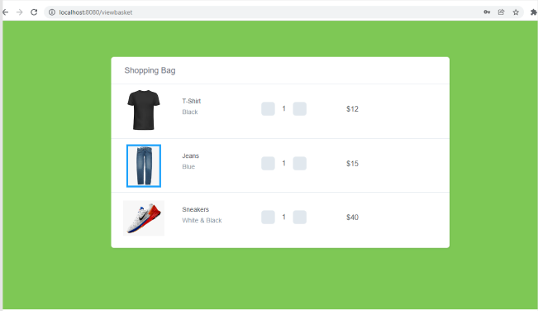
Development
FRONT END
BACK END

Slide 10
Improvements...

Slide 11
Any questions?

Slide 12
Thanks for watching!

